Slide 1
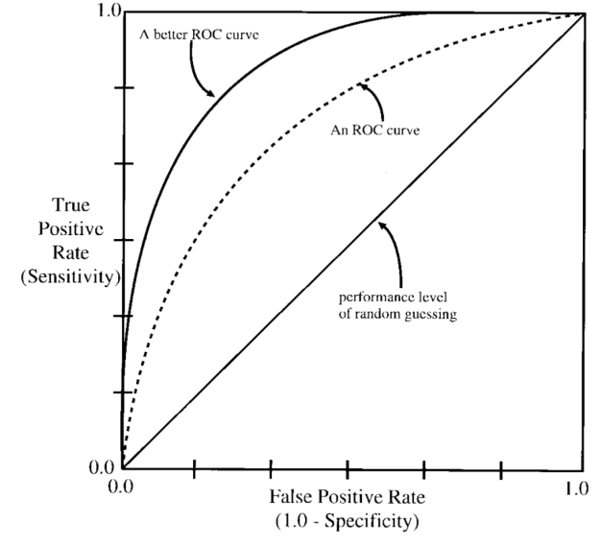
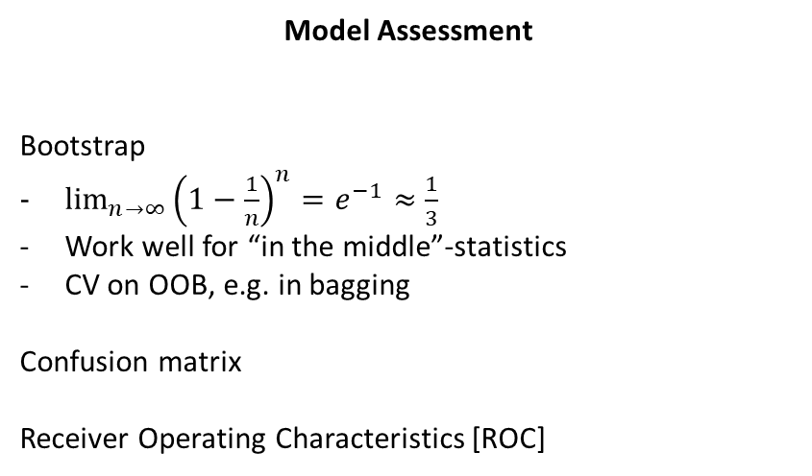
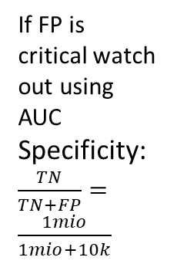
Lecture 2
Model Complexity and Selection
Over/Under fit
Cross Validation
Randomize data before splitting
Normalize separately
If data has structure – preserve it
Be careful with time series
Model Assessment
Bootstrap
$\lim_{n→∞}{{\left(1−\frac{1}{n}\right)}^{n}=e^{−1}≈\frac{1}{3}}$
Work well for “in the middle”-statistics
CV on OOB, e.g. in bagging
Confusion matrix
Receiver Operating Characteristics [ROC]
If FP is critical watch out using AUC
Specificity: $\frac{TN}{TN+FP}=\frac{1mio}{1mio+10k}$
Bias | Variance
More complex model | Regularize
Better optimizer | More data
Hyper parameter | Hyper parameter

Slide 2


Lecture 2
Model Selection by Information Criteria
C_{p}-statistics (expected in-sample error, variance+ noise):
$$C_{p}=\overline{err}+2\frac{d}{N}{\hat{σ}}_{e}^{2}$$
$\overline{err}≈\frac{1}{N}\sum_{i=1}^{N}{{\left(y_{i}−x_{i}\hat{β}\right)}^{2}}$, and for low bias method ${\hat{σ}}_{e}^{2}≈MSE$
Akaike Information Criterion (small N):
$$AIC=−\frac{2}{N}logL+2\frac{d}{N}$$
For gaussian regression models:
$$AIC\left(λ\right)=\overline{err}\left(λ\right)+2\frac{d(λ)}{N}{\hat{σ}}_{e}^{2}$$
Bayes Information Criterion (large N):
$$BIC=−2logL+\log\left(N\right)d$$
For gaussian regression models:
$$BIC\left(λ\right)=\frac{N}{{\hat{σ}}_{e}^{2}}(\overline{err}\left(λ\right)+\log\left(N\right)\frac{d(λ)}{N}{\hat{σ}}_{e}^{2})$$
MLE for gaussian models:
$$\sum_{i=1}^{N}{log⁡(p_{β}\left(y_{i} | x_{i}\right))}$$
$$=\sum_{i=1}^{N}{log⁡\left[\frac{1}{σ\sqrt{2π}}exp\left(−\frac{{\left(y_{i}−x_{i}β\right)}^{2}}{2σ^{2}}\right)\right]}$$
$$=\sum_{i=1}^{N}{\log\left[\frac{1}{σ\sqrt{2π}}\right]}+\sum_{i=1}^{N}{−\frac{{\left(y_{i}−x_{i}β\right)}^{2}}{2σ^{2}}}$$
Resulting in the same optimization problem as for OLS
$$\arg{\min_{β}{\sum_{i=1}^{N}{{\left(y_{i}−x_{i}β\right)}^{2}}}}$$

